Slide 1
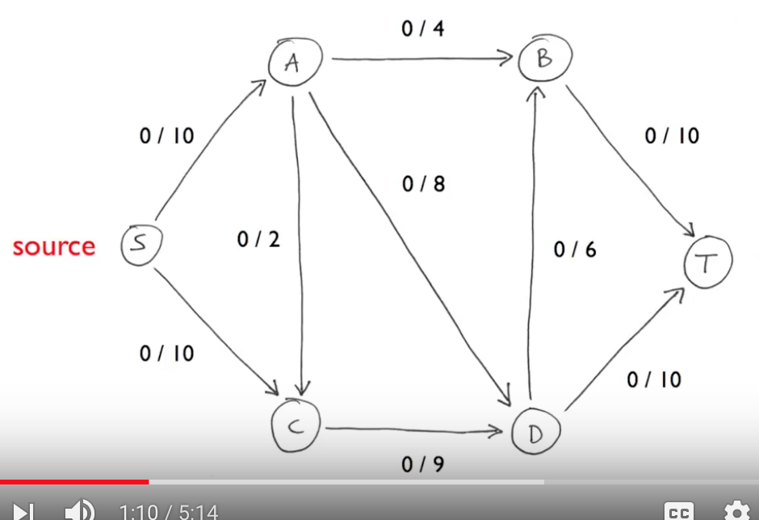
Ford Fulkerson Algorithm for Maximum Flow in a flow network

Slide 2
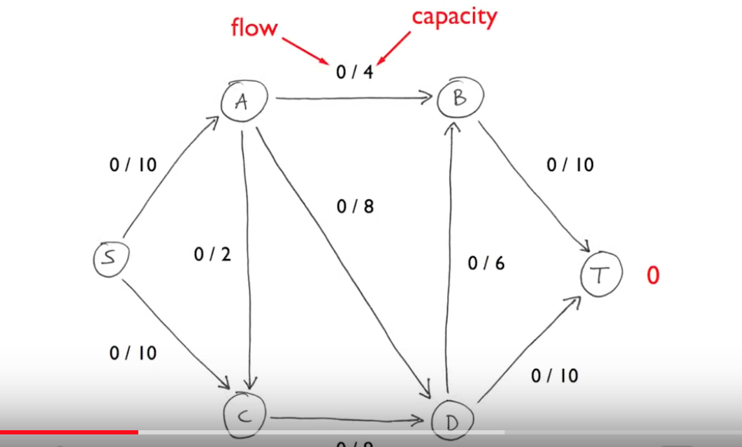

Slide 3
Algorithm steps
Process start with 0 flow and continue
until there exists an augmenting path
find an augmenting path
compute bottleneck capacity
increase total flow by the bottleneck capacity.
Process terminates when, all paths from S to T are blocked
by either full forward edge or empty backward edge,
and no more augmenting paths are available.

Slide 4
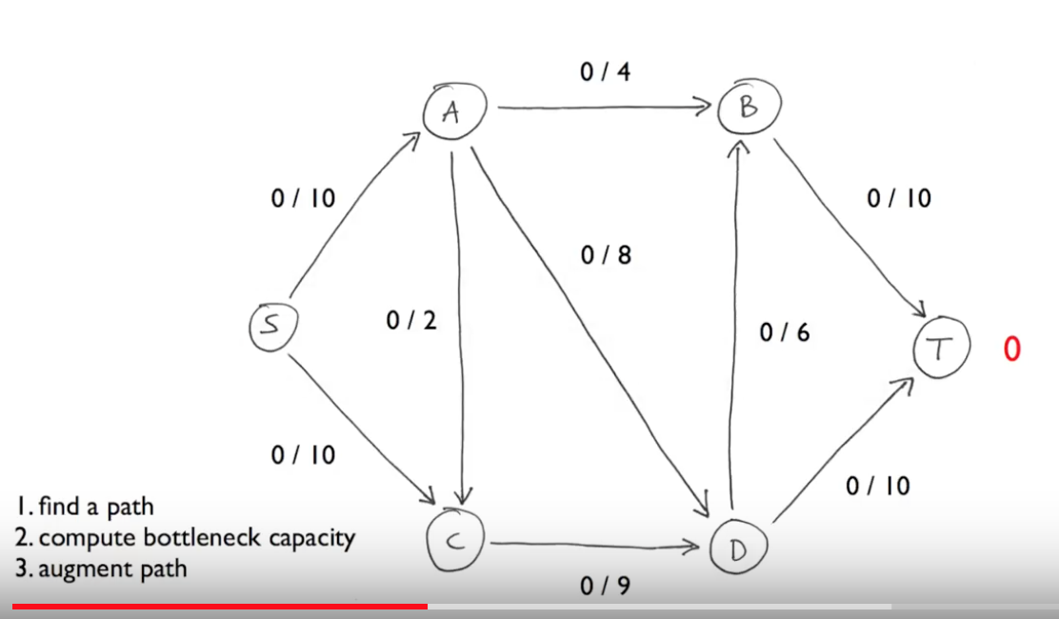

Slide 5
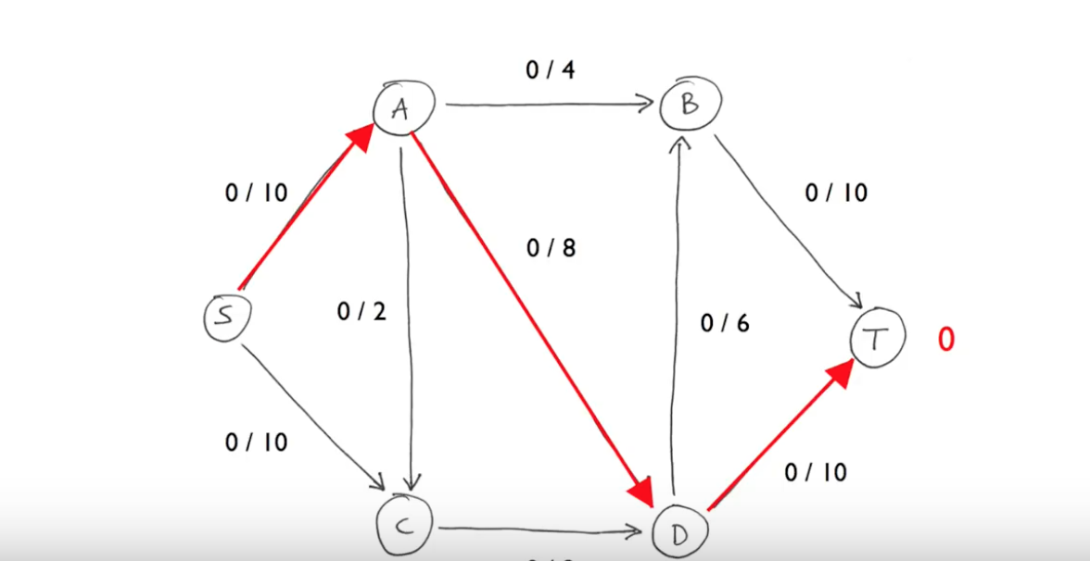

Slide 6
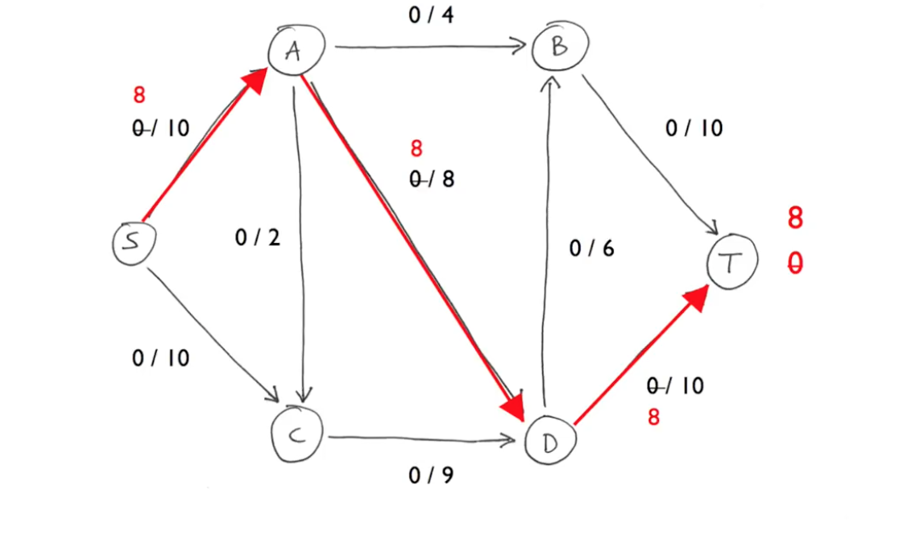

Slide 7
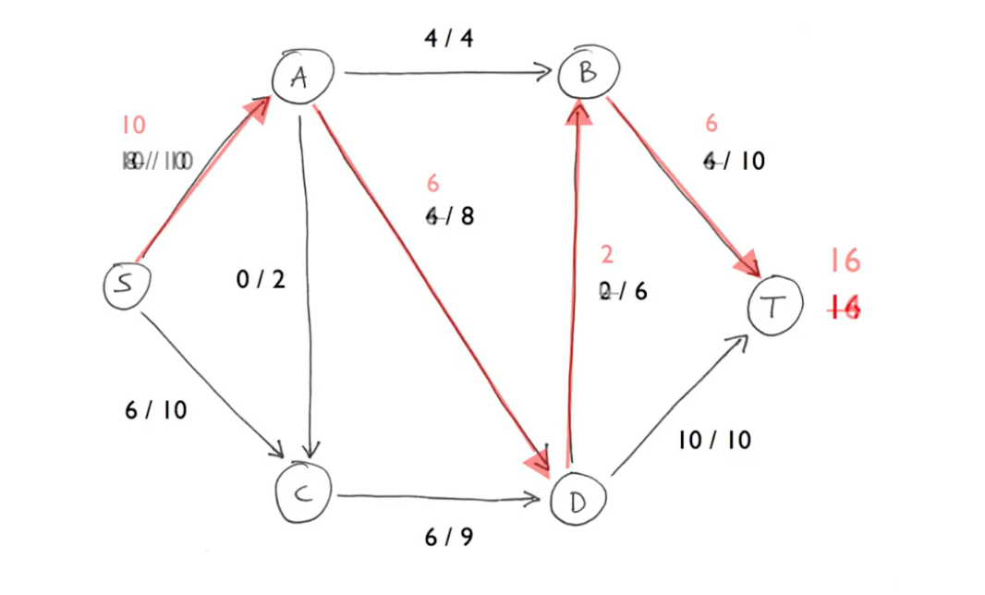

Slide 8
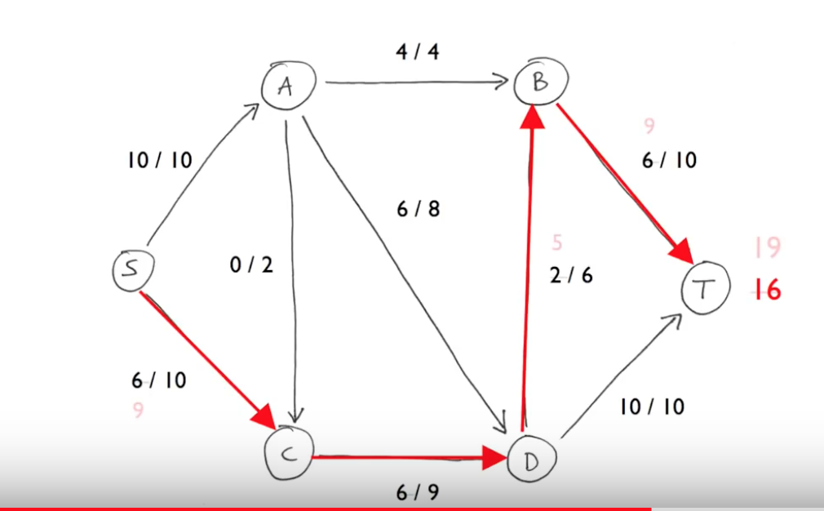

Slide 9
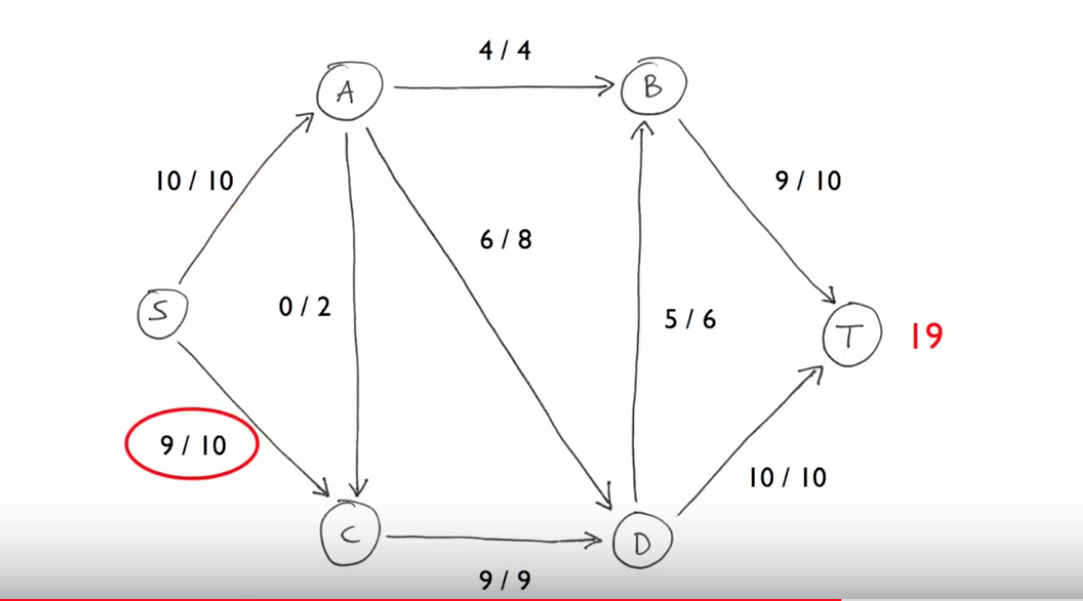

Slide 10
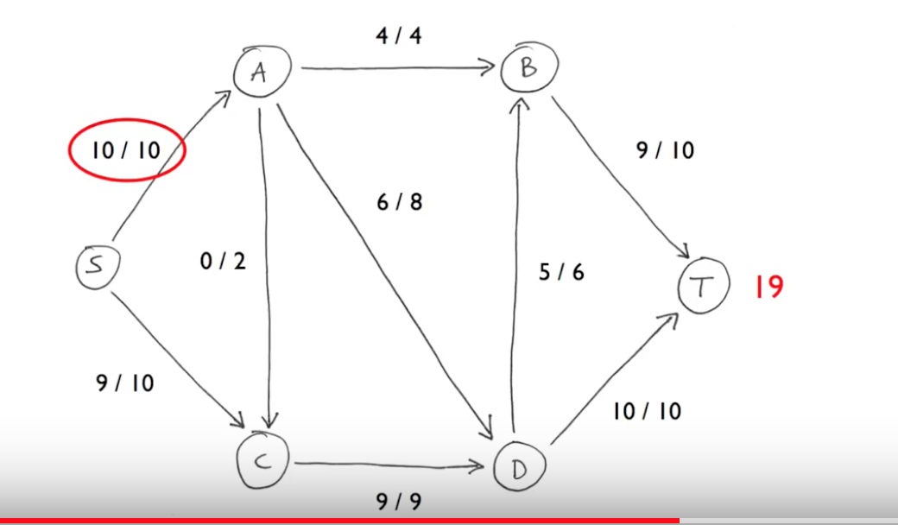

Slide 11
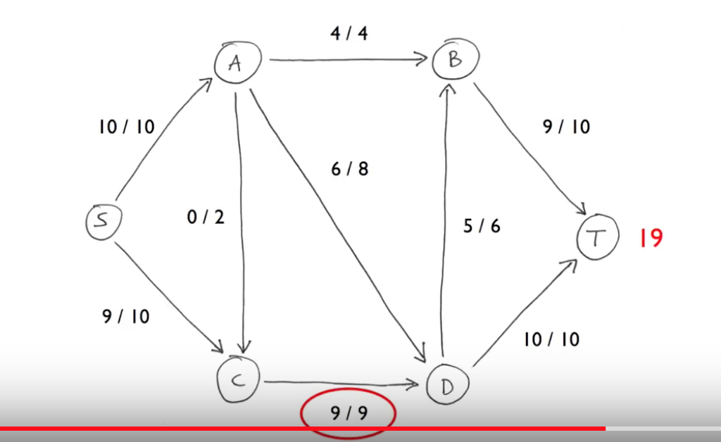

Slide 12
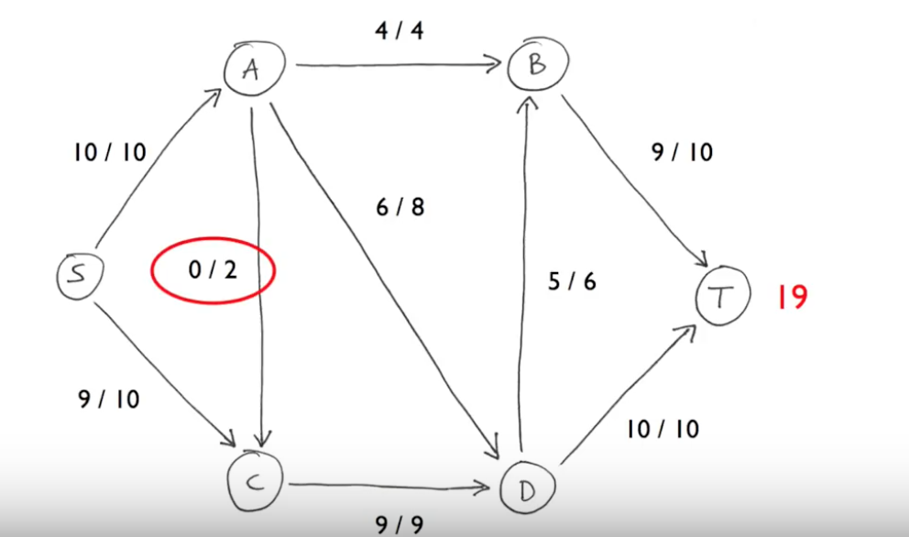

Slide 13
A 10+1=1+7 +4
C 10 = 9+1
D 9+7 = 6 +10
B 4+6 = 10

Slide 14
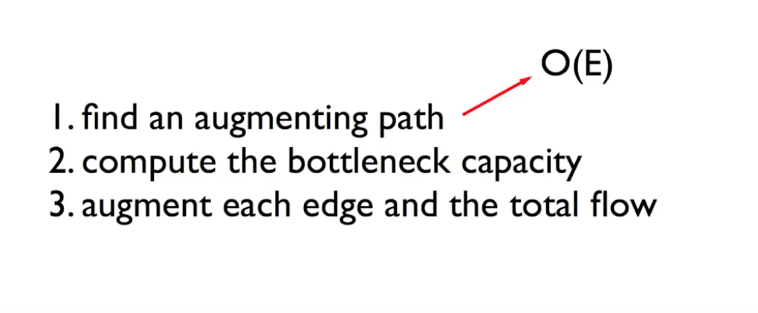

Slide 15
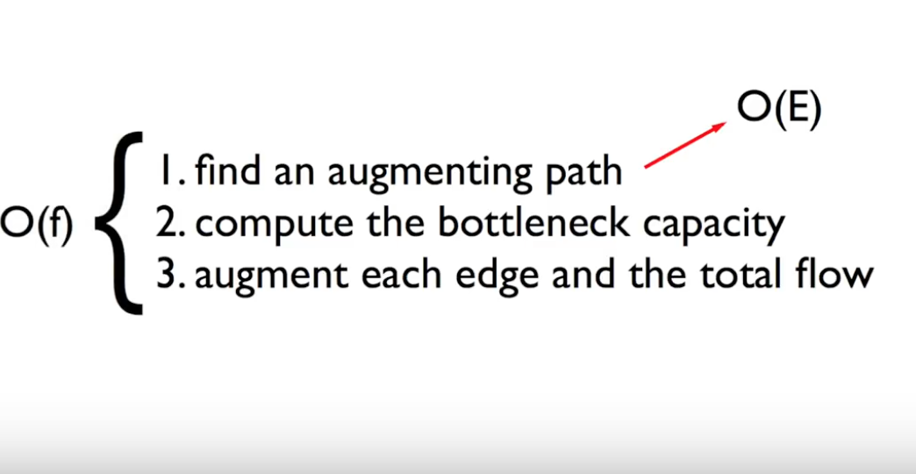

Slide 16
